Slide 1
Photomicrographs of Plant foods
Bean: Kidney
Permission to reproduce original photomicrographs used to make this collection may be obtained from
Dr. David O. Norris at
david.norris@colorado.edu

Slide 2
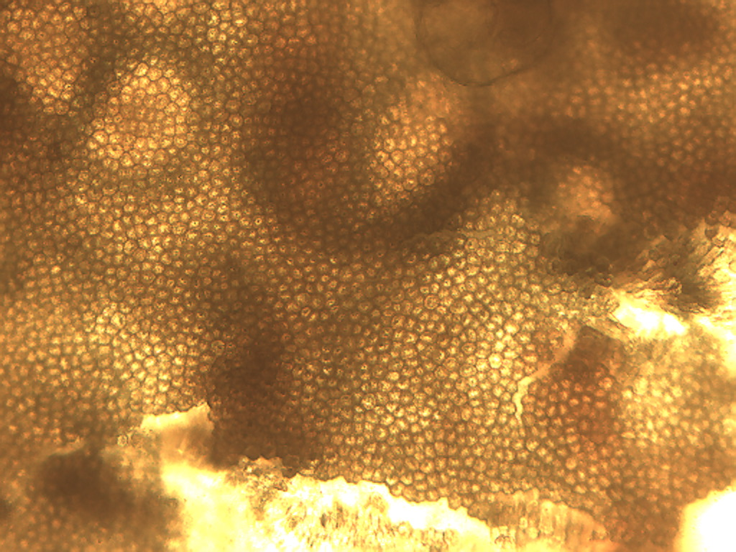
Notes:
53. Phaseolus vulgaris L. Bean, kidney. Seed coat surface, no filter, 10X.

Slide 3
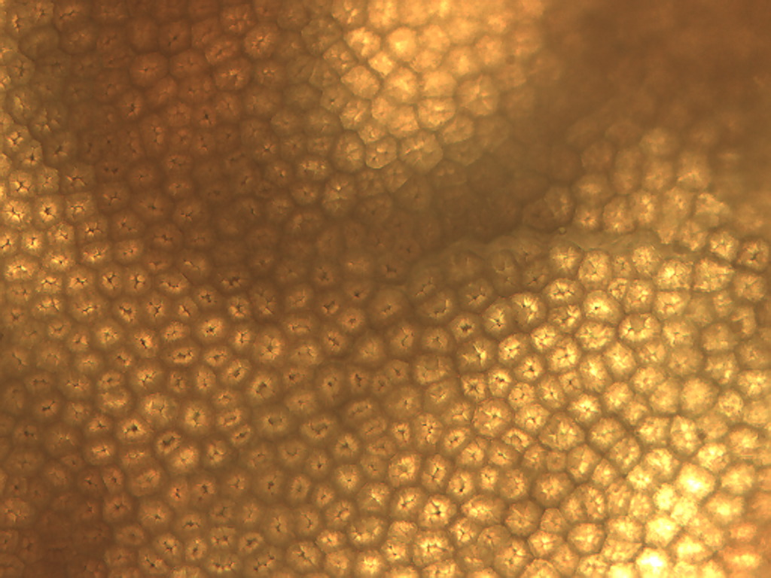
Notes:
54. Bean, kidney. Seed coat, no filter, 25X.

Slide 4
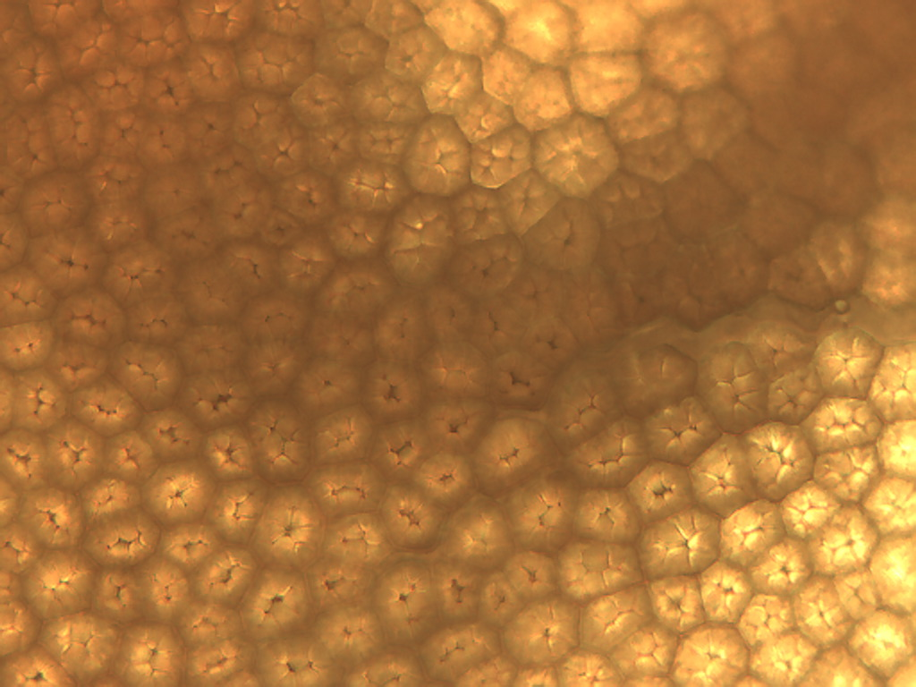
Notes:
55. Bean, kidney. Seed coat, 40X.

Slide 5
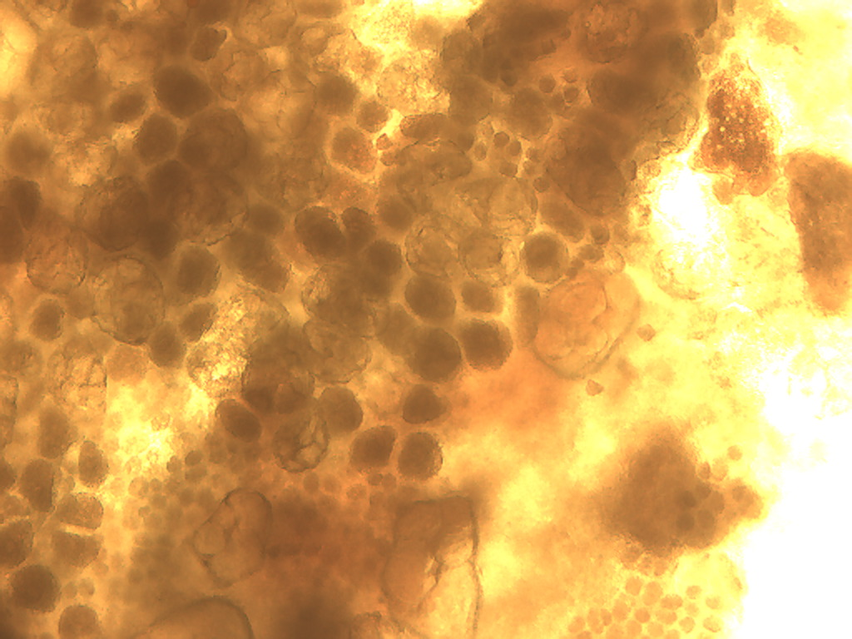
Notes:
56. Bean, kidney. Small parenchyma beneath surface of seed coat, no filter, 10X.

Slide 6
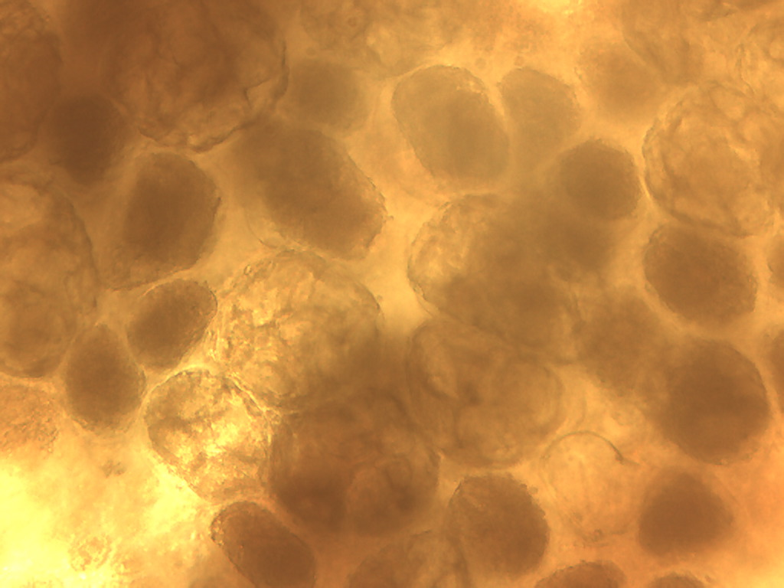
Notes:
57. Bean, kidney. Small parenchyma beneath surface of seed coat, no filter, 25X.

Slide 7
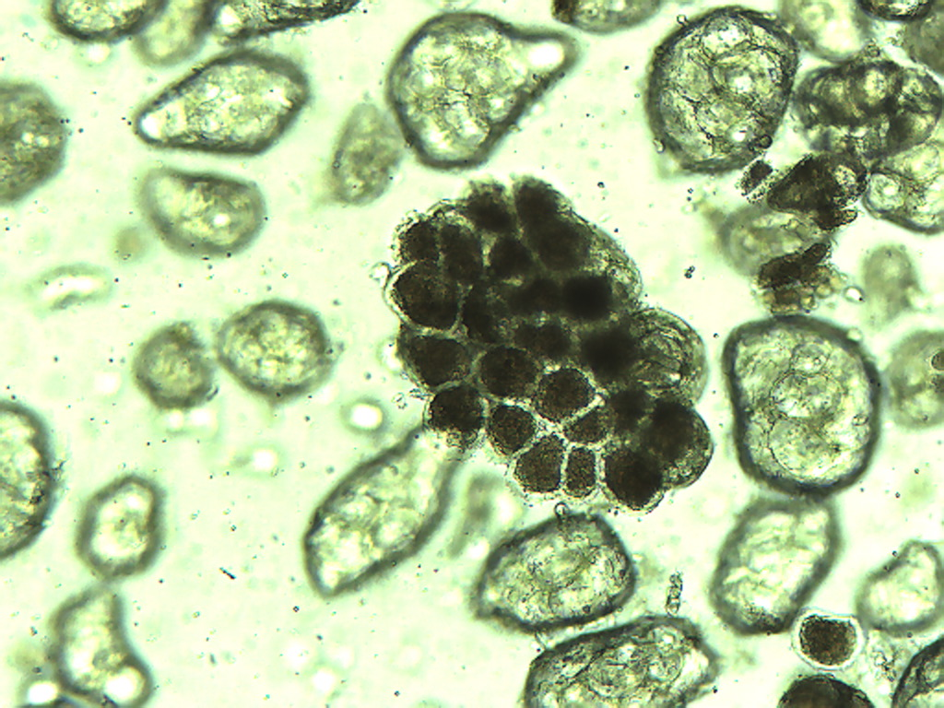
Notes:
58. Bean, kidney. Small parenchyma, 10X.

Slide 8
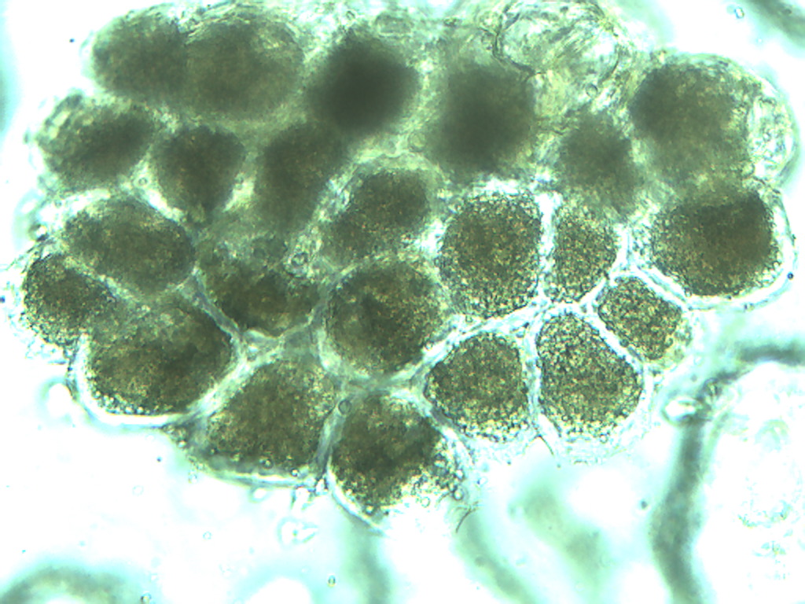
Notes:
59. Bean, kidney. Small parenchyma, 25X.

Slide 9
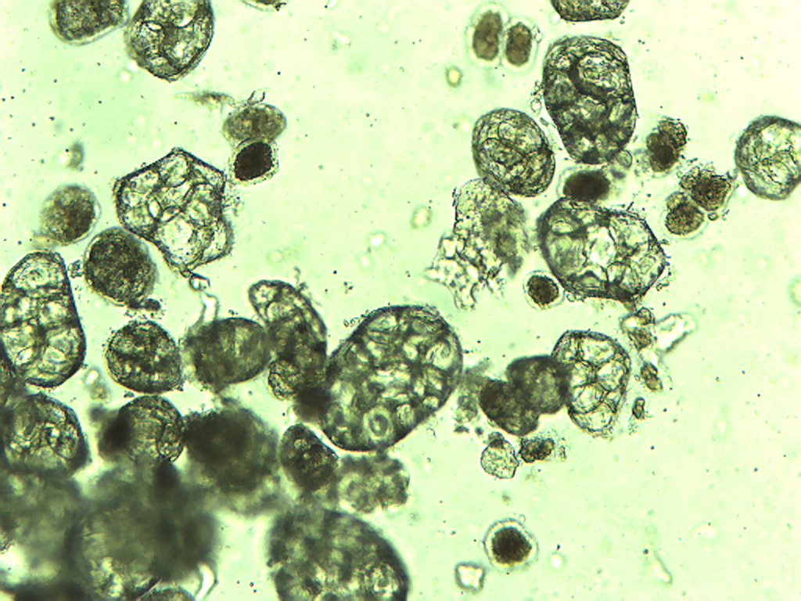
Notes:
60. Bean, kidney. Parenchymal cells. 10X

Slide 10
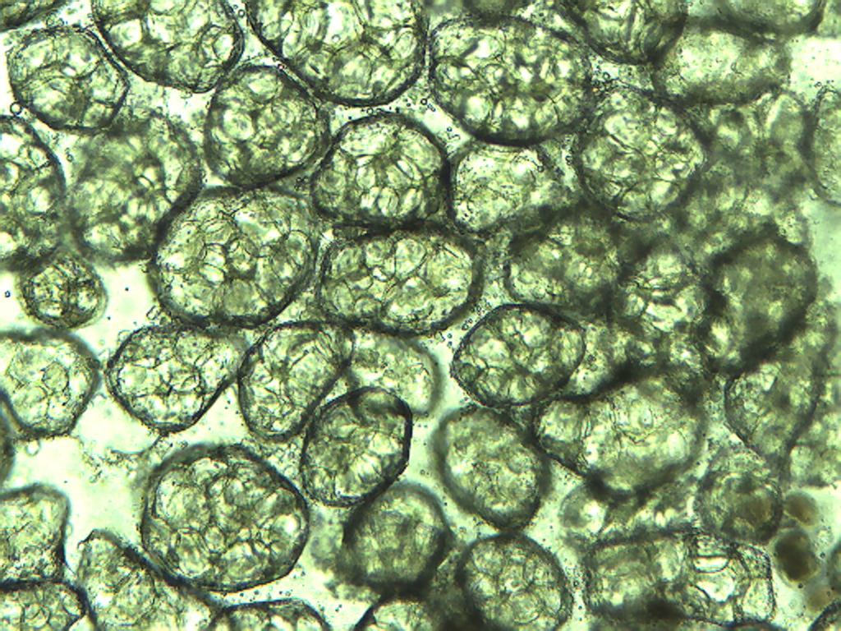
Notes:
61. Bean, kidney. Large parenchymal cells, 10X.

Slide 11
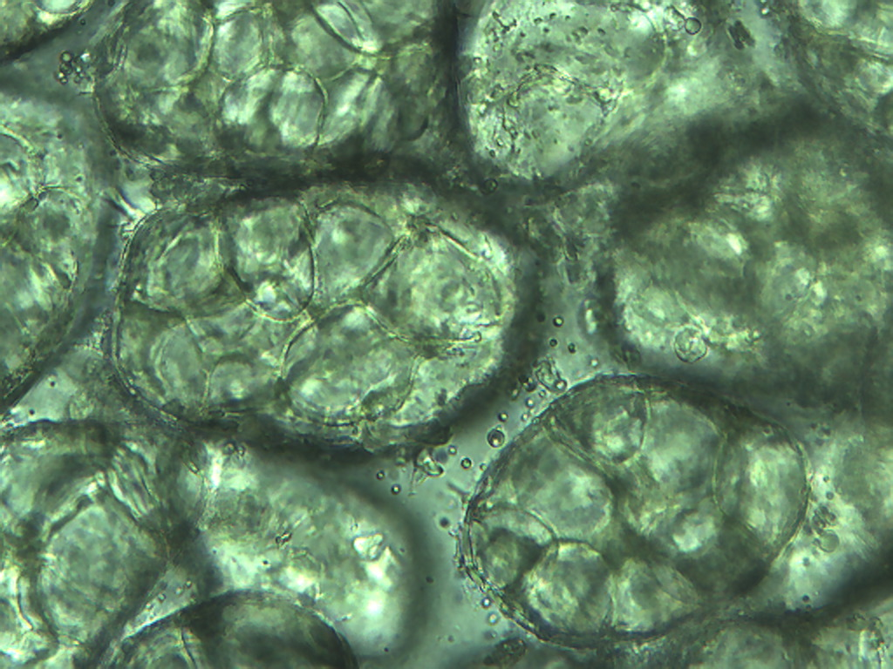
Notes:
62. Bean, kidney. Large parenchymal cells, 25X.

Slide 12
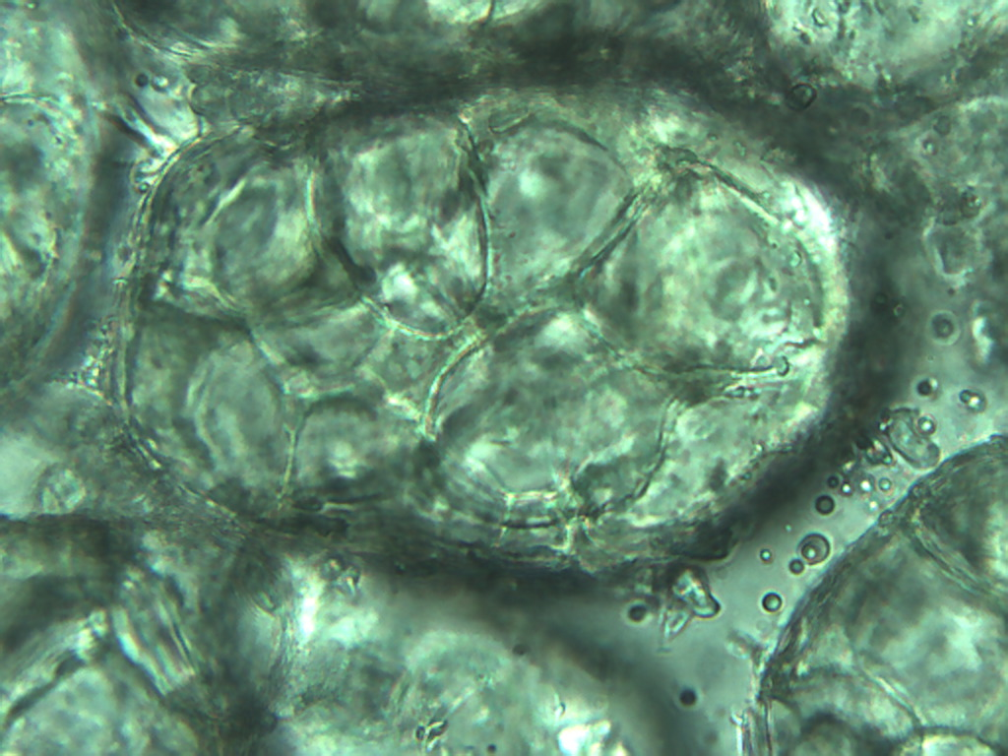
Notes:
63. Bean, kidney. Large parenchymal cell, 40X.

